Slide 1
Graphical User Interfaces (GUI)
Abstract Windows Toolkit (AWT): java.awt
GUI elements:
Primitive
Button, Label, Checkbox, Scrollbar, etc.
Container
Panel, Frame, Dialog, etc.
Layout managers:
FlowLayout, BorderLayout, etc.
Supporting classes:
Event handling
java.awt.event package
Graphics
Color, Font, Graphics, etc.
Geometry
Point, Rectangle, Dimension, etc.
Imaging
Image class and java.awt.image package

Slide 2
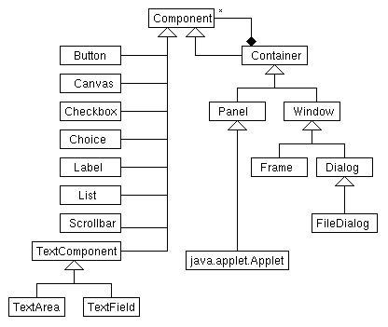
The Component Hierarchy

Slide 3
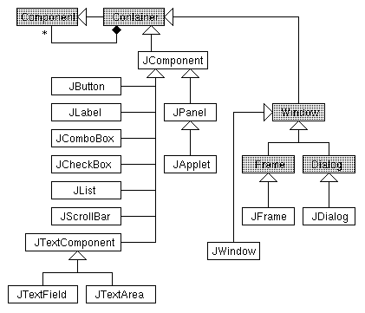
The Swing Components

Slide 4
Layout Managers
The layout of the elements in a container is handled by the layout manager associated with the container.
Relative positions of the elements are specified, not their absolute coordinates.
The positions and sizes of the element will be automatically adjusted when the window is resized.

Slide 5
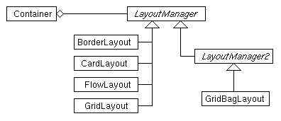
The Layout Manager Hierarchy

Slide 6
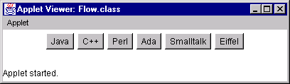
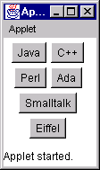
Buttons and Flow Layout
width=400 height=50
width=100 height=120

Slide 7
Buttons and Flow Layout (cont'd)
Layout elements in horizontal rows.
import java.awt.*;
import java.applet.Applet;
public class Flow extends Applet {
public Flow () {
setLayout(new FlowLayout());
add(new Button("Java"));
add(new Button("C++"));
add(new Button("Perl"));
add(new Button("Ada"));
add(new Button("Smalltalk"));
add(new Button("Eiffel"));
}
}

Slide 8
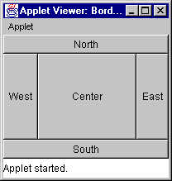
Border Layout

Slide 9
Border Layout (cont'd)
import java.awt.*;
import java.applet.Applet;
public class Border extends Applet {
public Border () {
setLayout(new BorderLayout());
add(new Button("North"), BorderLayout.NORTH);
add(new Button("South"), BorderLayout.SOUTH);
add(new Button("East"), BorderLayout.EAST);
add(new Button("West"), BorderLayout.WEST);
add(new Button("Center"), BorderLayout.CENTER);
}
}

Slide 10
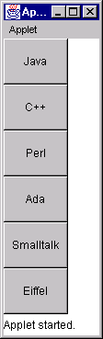
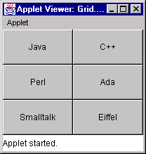
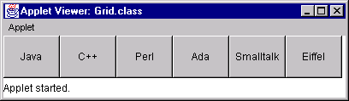
Grid Layout
row=3 col=2
row=0 col=1
row=1 col=0

Slide 11
Grid Layout (cont'd)
import java.awt.*;
import java.applet.Applet;
public class Grid extends Applet {
public void init () {
int row = 0, col = 0;
String att = getParameter("row");
if (att != null)
row = Integer.parseInt(att);
att = getParameter("col");
if (att != null)
col = Integer.parseInt(att);
if (row == 0 && col == 0) {
row = 3; col = 2;
}

Slide 12
Grid Layout (cont'd)
(class Grid continued.)
setLayout(new GridLayout(row, col));
add(new Button("Java"));
add(new Button("C++"));
add(new Button("Perl"));
add(new Button("Ada"));
add(new Button("Smalltalk"));
add(new Button("Eiffel"));
}
}

Slide 13
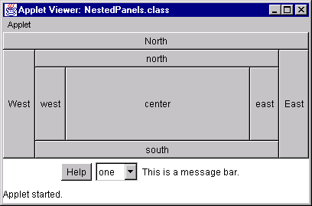
Nested Panels

Slide 14
Nested Panels (cont'd)
public class NestedPanels extends Applet {
protected Label messageBar;
protected Choice choice;
public NestedPanels () {
// set up the center panel
Panel center = new Panel();
center.setLayout(new BorderLayout());
center.add(new Button("south"),
BorderLayout.SOUTH);
center.add(new Button("north"),
BorderLayout.NORTH);
center.add(new Button("east"),
BorderLayout.EAST);
center.add(new Button("west"),
BorderLayout.WEST);
center.add(new Button("center"),
BorderLayout.CENTER);

Slide 15
(class NestedPanels continued.)
// set up the south panel
Panel south = new Panel();
south.setLayout(new FlowLayout());
south.add(new Button("Help"));
choice = new Choice();
choice.addItem("one");
choice.addItem("two");
choice.addItem("three");
choice.addItem("four");
choice.addItem("five");
south.add(choice);
messageBar = new Label("This is a message bar.");
south.add(messageBar);

Slide 16
Nested Panels (cont'd)
(class NestedPanels continued.)
// set up the outer panel
setLayout(new BorderLayout());
add(new Button("North"), BorderLayout.NORTH);
add(new Button("East"), BorderLayout.EAST);
add(new Button("West"), BorderLayout.WEST); add(south, BorderLayout.SOUTH);
add(center, BorderLayout.CENTER);
}
}

Slide 17
Event Handling
Event source: buttons, checkboxes, choices
Event listener: any class interested in handling certain events
A listener must
implement an appropriate listener interface;
inform the source that it is interested in handling a certain type of events.
A listener may listen to several sources and different types of events.
The source may also be the listener.
Listeners can be full-fledged classes or inner classes.

Slide 18
The Event Object and Listener Classes
ActionEvent ActionListener
ItemEvent ItemListener
MouseEvent MouseListener MouseMotionListener
MouseAdapter MouseMotionAdapter
KeyEvent KeyListener
KeyAdapter
WindowEvent WindowListener
WindowAdapter
XyzListener are interfaces.
XyzAdapter are classes that implement the corresponding listener interfaces.

Slide 19
Nested Panels, Handling Events
import java.awt.*;
import java.awt.event.*;
public class NestedPanels2 extends NestedPanels
implements ActionListener, ItemListener {
public NestedPanels2() {
super(); // create all the components
// register item listener
choice.addItemListener(this);
// register action listener
registerButtonHandler(this);
}
<Event handling methods>
<Method registerButtonHandler()>
}

Slide 20
Event Handling Methods
public void itemStateChanged(ItemEvent event) {
if (event.getStateChange() ==
ItemEvent.SELECTED) {
messageBar.setText("Choice selected: " +
event.getItem());
}
}
public void actionPerformed(ActionEvent event) {
Button source = (Button) event.getSource();
messageBar.setText("Button pushed: " +
source.getLabel());
}

Slide 21
Register The Listener
protected
void registerButtonHandler(Component comp) {
if (comp != null) {
if (comp instanceof Button) {
Button button = (Button) comp;
button.addActionListener(this);
} else if (comp instanceof Container) {
Container container = (Container) comp;
int n = container.getComponentCount();
for (int i = 0; i < n; i++)
registerButtonHandler(
container.getComponent(i));
}
}
}

Slide 22
Event Handling Using Inner Class
import java.awt.*;
import java.awt.event.*;
public class NestedPanels3
extends NestedPanels {
public NestedPanels3() {
super();
ChoiceEventHandler cHandler =
new ChoiceEventHandler();
choice.addItemListener(cHandler);
ButtonEventHandler bHandler =
new ButtonEventHandler();
bHandler.registerButtonHandler(this);
}
<Inner class ChoiceEventHandler>
<Inner class ButtonEventHandler>
}

Slide 23
Inner Class Listener
Inner classes
classes that reside inside other (full-fledged) classes.
Intended to be small.
serve as helpers to the enclosing class.
class ChoiceEventHandler implements ItemListener {
public void itemStateChanged(ItemEvent event) {
if (event.getStateChange() ==
ItemEvent.SELECTED) {
messageBar.setText("Choice selected: " +
event.getItem());
}
}
}

Slide 24
Inner Class Listener (cont'd)
class ButtonEventHandler
implements ActionListener {
public void actionPerformed(ActionEvent event){
Button source = (Button) event.getSource();
messageBar.setText("Button pushed: " +
source.getLabel());
}

Slide 25
Inner Class Listener (cont'd)
(class ButtonEventHandler continued.)
protected void
registerButtonHandler(Component comp) {
if (comp != null) {
if (comp instanceof Button) {
Button button = (Button) comp;
button.addActionListener(this);
} else if (comp instanceof Container) {
Container container = (Container) comp;
int n = container.getComponentCount();
for (int i = 0; i < n; i++)
registerButtonHandler(
container.getComponent(i));
}
}
}
}

